Slide 1
MCS 8302
CNS 2205
Network Programming
Nagios and Cacti

Slide 2
Importance of System Monitoring
Early Detection of Issues:
  Identify problems before they impact users or critical operations.
Performance Optimization:
  Analyze system performance to optimize resource usage and improve efficiency.
Capacity Planning:
  Understand usage trends to plan for future system capacity and upgrades.
Security:
  Monitor for unauthorized access, potential security breaches, or unusual system behavior.

Slide 3
SNMP
SNMP is an application-layer protocol that facilitates the exchange of management information between network devices.
Facilitates monitoring and management of network devices and systems.

Slide 4
Components of SNMP
SNMP Manager:
  The system or software responsible for managing and monitoring network devices.
SNMP Agent:
  Software module residing on network devices that provides data and responds to SNMP requests.
Management Information Base (MIB):
  Database that organizes managed objects for access via SNMP.
    MIB Structure: Hierarchy of managed objects represented by a unique identifier (OID - Object Identifier).
    Types of MIB: Standard MIBs (defined by standard organizations like IETF) and Enterprise MIBs (specific to individual vendors).
SNMP Community Strings
  SNMP Community: A community string acts as a password to control access to the SNMP agent.
  Types: Read-Only (RO) and Read-Write (RW) community strings

Slide 5
SNMP Operations
GET:
  Requests information for a specific OID from an SNMP agent.
SET:
  Modifies the value of a specific OID on an SNMP agent.
GET-NEXT:
  Retrieves the next OID in the MIB hierarchy.
TRAP:
  Informs the SNMP manager of an event or condition on the SNMP agent.

Slide 6
SNMP Access Control
SNMP Community Strings
  SNMP Community: A community string acts as a password to control access to the SNMP agent.
  Types: Read-Only (RO) and Read-Write (RW) community strings

Slide 7
NAGIOS
Nagios is an open-source monitoring system designed to monitor network resources.
Founded in 1999, Nagios has become a standard in the industry for network monitoring.
Developed in C language and widely used in both small and large-scale environments.

Slide 8
Key Features of Nagios
Flexible notification and alerting system
Ability to monitor hosts, services, and network protocols
Extensible plugin architecture
Performance graphs and trend analysis
Distributed monitoring capabilities

Slide 9
Nagios Architecture
Nagios Core:
  The core monitoring engine that processes checks and handles alerts.
Plugins:
  External scripts or executables that perform the actual monitoring checks.
NRPE (Nagios Remote Plugin Executor):
  Allows Nagios to execute plugins on remote Linux/Unix machines.
Web Interface:
  Provides a graphical representation and control of the monitoring process.

Slide 10
Monitoring System Resources with Nagios
CPU Usage:
  Monitoring processor load and usage.
Memory Usage:
  Tracking memory consumption and availability.
Disk Usage:
  Monitoring disk space and usage.
Network Traffic:
  Monitoring incoming and outgoing network traffic.

Slide 11
CACTI
Definition: Cacti is an open-source network monitoring and graphing tool designed to visualize time-series data.
Purpose: Cacti allows users to monitor and graph performance metrics of network devices and systems.

Slide 12
Key Features of Cacti
Graphing Capabilities: Create detailed graphs to visualize data trends over time.
Data Collection: Collect data through various protocols like SNMP, scripts, and more.
User-Friendly Interface: Intuitive web-based interface for easy configuration and management.
Automation: Automate graph creation, data collection, and report generation.

Slide 13
Cacti Architecture
Cacti Poller
  Responsibility: The core engine responsible for collecting data at regular intervals from various devices and data sources.
  Polling Interval: Configurable time intervals at which data is collected from devices.
  Data Collection Methods: Utilizes SNMP, scripts, and other methods to gather data.
Data Sources
  Definition: Represent specific metrics to be monitored (e.g., CPU usage, memory utilization, network traffic).
  Types of Data Sources:
  SNMP Data Source: Collects data via SNMP queries.
  Script Data Source: Utilizes custom scripts to gather data.

Slide 14
Cacti Architecture
Cacti Poller
  Responsibility: The core engine responsible for collecting data at regular intervals from various devices and data sources.
  Polling Interval: Configurable time intervals at which data is collected from devices.
  Data Collection Methods: Utilizes SNMP, scripts, and other methods to gather data.
Data Sources
  Definition: Represent specific metrics to be monitored (e.g., CPU usage, memory utilization, network traffic).
  Types of Data Sources:
  SNMP Data Source: Collects data via SNMP queries.
  Script Data Source: Utilizes custom scripts to gather data.

Slide 15
Cacti Architecture
Data Templates
  Purpose: Define how to handle and display data from data sources.
  Configuration Parameters: Specifies graphing options, data collection methods, and presentation formats.
Graph Templates
  Definition: Blueprint for how graphs are presented based on data from data templates.
  Configuration Parameters: Defines graph title, axis labels, colors, and other visual aspects.

Slide 16
Cacti Architecture
RRDtool (Round-Robin Database Tool)
  Role: Handles data storage and management for Cacti.
  RRD Files: Stores collected data in round-robin databases, optimizing for performance and efficiency.
  Consolidation and Averaging: Aggregates data at specified intervals to maintain long-term data while reducing storage needs.
Cacti Web Interface
  User Interface: Provides an intuitive web-based interface for configuration, monitoring, and graph viewing.
  Configuration Settings: Allows users to configure devices, data sources, templates, and graphs.
  Graph Viewing: Enables users to view and analyze graphs for monitoring purposes.

Slide 17
ELK
Definition: The ELK Stack is a set of three open-source tools used for log processing and analysis: Elasticsearch, Logstash, and Kibana.
Integration: Combines the strengths of Elasticsearch, Logstash, and Kibana to centralize logs, process data, and visualize information.

Slide 18
ELK Stack Components
Elasticsearch
  Search and Analytics Engine: Provides a distributed, RESTful search and analytics engine for data storage and retrieval.
  Data Indexing: Indexes and stores the data in a scalable and efficient manner, allowing for fast search and analysis.
Logstash
  Data Processing Pipeline: Ingests and processes data from various sources, transforms it, and sends it to Elasticsearch for indexing.
  Input, Filter, Output Plugins: Modular components for input, filtering, and output operations to handle different data formats and sources.
Kibana
  Data Visualization and Dashboard: Web-based interface for exploring, visualizing, and creating dashboards of the data stored in Elasticsearch.
  Interactive Visualizations: Allows users to create various visualizations (e.g., charts, graphs, maps) and customize dashboards.

Slide 19
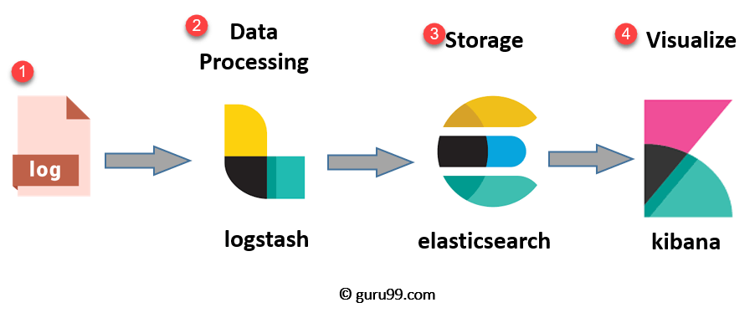
ELK Stack Architecture

Slide 20
Integration and Workflow
Log Collection:
  Logstash collects logs from various sources (applications, servers, etc.).
Data Processing:
  Logstash processes and enriches the logs, preparing them for indexing.
Data Indexing:
  Elasticsearch indexes the processed logs for efficient storage and retrieval.
Data Visualization:
  Kibana provides a graphical interface to visualize and analyze the data.

Slide 21
ELK Stack Use Cases
Log Monitoring and Analysis
  Centralized Log Management: Aggregate logs from various sources for easy monitoring and analysis.
  Anomaly Detection: Identify abnormal patterns or events within logs for proactive troubleshooting.
Security Monitoring
  Intrusion Detection: Detect and respond to potential security threats by analyzing logs for suspicious activities.
  Compliance Reporting: Generate compliance reports by analyzing logs against specific security standards.

